Slide 1
CSDS 451: Designing High Performant Systems for AI
Lecture 15
10/16/2024
Sanmukh Kuppannagari
sanmukh.kuppannagari@case.edu
https://sanmukh.research.st/
Case Western Reserve University

Slide 2
Outline
Transformer Models
Transformer Models – Computational Challenges

Slide 3
Announcements
Midterm Graded

Slide 4
Outline
Transformer Models
Transformer Models – Computational Challenges

Slide 5
Transformer Based Models
Neural network for language modeling that use Transformer Architecture as a key building block
State of the art architectures for most of the Natural Language Processing Tasks
ChatGPT, Llama, …

Slide 6

Transformer Models
Key Idea: Attention Mechanism
Original paper: Attention Is All You Need: https://arxiv.org/abs/1706.03762

Slide 7
Transformer Models
$N$ Layers of Decoder Blocks
$N$ Layers of Encoder Blocks

Slide 8
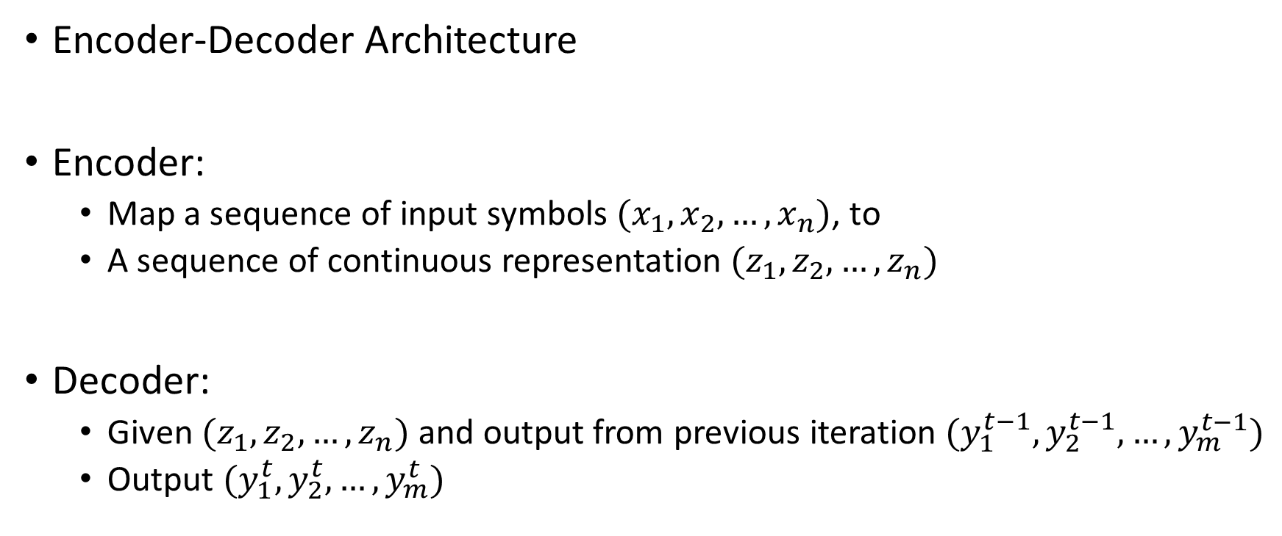
Transformer Models
Encoder-Decoder Architecture
Encoder:
Map a sequence of input symbols $(x_{1}, x_{2},…,x_{n})$, to
A sequence of continuous representation $(z_{1},z_{2},…,z_{n})$
Decoder:
Given $(z_{1},z_{2},…,z_{n})$ and output from previous iteration $(y_{1}^{t−1},y_{2}^{t−1},…,y_{m}^{t−1})$
Output $(y_{1}^{t},y_{2}^{t},…,y_{m}^{t})$

Slide 9
Transformer Models - Encoder
$$(z_{1},z_{2},…,z_{n})$$
Transformer Encoder Block
$$(x_{1}, x_{2},…,x_{n})$$

Slide 10
Transformer Models - Decoder
$$(y_{1}^{t},y_{2}^{t},…,y_{m}^{t})$$
Transformer Decoder Block
$$(z_{1},z_{2},…,z_{n})$$
$$(y_{1}^{t−1},y_{2}^{t−1},…,y_{m}^{t−1})$$

Slide 11
Transformer Models - Inference
The actual process depends upon the task
Here we will consider a simple sentence prediction
Input: AI stands for
Output: Artificial Intelligence

Slide 12
Transformer Models - Inference
$N$ Layers of Decoder Blocks
$N$ Layers of Encoder Blocks
Generate the input embeddings

Slide 13
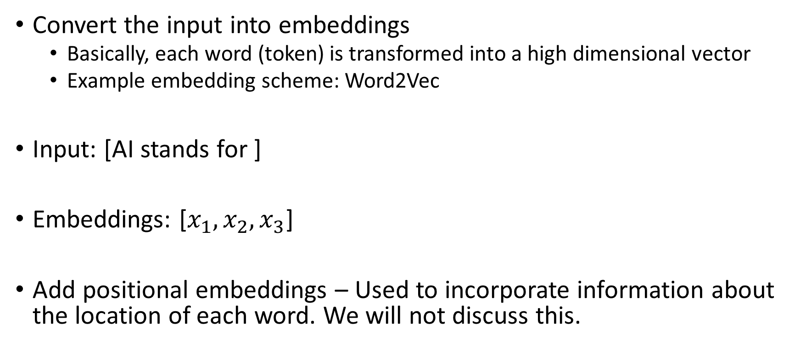
Transformer Models - Inference
Convert the input into embeddings
Basically, each word (token) is transformed into a high dimensional vector
Example embedding scheme: Word2Vec
Input: [AI stands for ]
Embeddings: [$x_{1}, x_{2},x_{3}$]
Add positional embeddings – Used to incorporate information about the location of each word. We will not discuss this.

Slide 14
Transformer Models - Inference
Input Encoding Phase
Perform Multi-headed Attention

Slide 15
Transformer Models - Inference
Input Encoding Phase
Feed-forward Network

Slide 16
Transformer Models - Inference
Input Encoding Phase
Perform $N$ times using $N$ different layers

Slide 17
Transformer Models - Inference
Input Encoding Phase
Produce Input Encoding: [$z_{1}, z_{2},z_{3}$]
Note, same length

Slide 18
Transformer Models - Inference
Once the input encodings are produced, the decoding phase starts
Proceeds in an iterative manner, in each iteration:
Using the output produced till now, produce the next token

Slide 19
Transformer Models - Inference
Feed forward Network
[$z_{1}, z_{2},z_{3}$]
Perform Multi-headed Attentions
Start with a special start token
<s>

Slide 20
Transformer Models - Inference
$$[y_{1}]$$
[Artificial]
[$z_{1}, z_{2},z_{3}$]
<s>

Slide 21
Transformer Models - Inference
$$[y_{2}]$$
[Intelligence]
[$z_{1}, z_{2},z_{3}$]
[<s>, $y_{1}$]

Slide 22
Transformer Models - Inference
$$[y_{3}]$$
[</s>]
Stop when a special stop signal is generated
[$z_{1}, z_{2},z_{3}$]
[<s>, $y_{1},y_{2}$]

Slide 23
Transformer Model Types
Encoder Only Models: Use only the Encoder portion for tasks
BERT
Good for tasks that require understanding the entire text
Example: Classification, similarity,
Decoder Only Models: Use only the Decoder portion for tasks
GPT
Good for auto-regressive tasks
Example: Text completion, Chatbots, code/text generation
Encoder-Decoder Models: Have both Encoder-Decoder portions
Original Transformer that we discussed, T5
Good for tasks that require input to output mappings
Example: Translation, summarization

Slide 24


Transformer Models - Encoder
$$(z_{1},z_{2},…,z_{n})$$
Transformer Encoder Block
$$(x_{1}, x_{2},…,x_{n})$$

Slide 25



Transformer Models - Decoder
$$(y_{1}^{t},y_{2}^{t},…,y_{m}^{t})$$
Transformer Decoder Block
$$(z_{1},z_{2},…,z_{n})$$
$$(y_{1}^{t−1},y_{2}^{t−1},…,y_{m}^{t−1})$$

Slide 26
Transformer Encoder Block
Contains two sub-layers
Attention Mechanism
Feed Forward Network

Slide 27
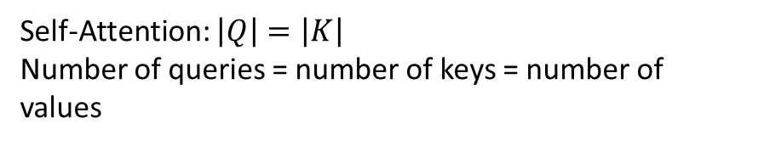







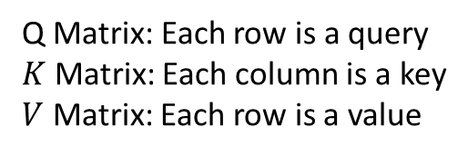








Attention Mechanism
$$Attention(Q,K,V)$$
$$d_{k}$$
$$d_{v}$$
$$q_{1}$$
$$v_{1}$$
$$q_{2}$$
$$v_{2}$$
$$q_{3}$$
$$v_{3}$$
Softmax
$$|Q|$$
X
$$k_{1}$$
$$k_{2}$$
$$k_{3}$$
X
$$|K|$$
$$d_{k}$$
$$|K|$$
Self-Attention: $\left|Q\right|=\left|K\right|$
Number of queries = number of keys = number of values
Q Matrix: Each row is a query
$K$ Matrix: Each column is a key
$V$ Matrix: Each row is a value
X: Matrix MM

Slide 28







Attention Mechanism
$$q_{1}$$
$$k_{1}$$
$$v_{1}$$
$$k_{2}$$
$$v_{2}$$
$$k_{3}$$
$$v_{3}$$
Attention Mechanism: Think of it as a lookup table
Given a query, output a value that is corresponding to the key that is most similar to query

Slide 29




Attention Mechanism
$$q_{1}.k_{1}$$
$$q_{1}$$
$$k_{1}$$
$$v_{1}$$
$$q_{1}.k_{2}$$
$$k_{2}$$
$$v_{2}$$
$$q_{1}.k_{3}$$
$$k_{3}$$
$$v_{3}$$
Attention Mechanism: Think of it as a general version of a lookup table
Lookup Table: Given a query, output a value that is corresponding to the key that is most similar to query

Slide 30


Attention Mechanism
$$q_{1}.k_{1}$$
$$q_{1}$$
$$k_{1}$$
$$v_{1}$$
$$q_{1}.k_{2}$$
$$k_{2}$$
$$v_{2}$$
$$q_{1}.k_{3}$$
$$k_{3}$$
$$v_{3}$$
Attention Mechanism: Think of it as a general version of a lookup table
Lookup Table: Given a query, output a value that is corresponding to the key that is most similar to query

Slide 31






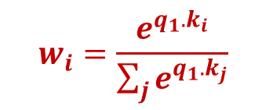


Attention Mechanism
$$w_{i}=\frac{e^{q_{1}.k_{i}}}{\sum_{j}{e^{q_{1}.k_{j}}}}$$
$$q_{1}.k_{1}$$
$$w_{1}$$
$$q_{1}$$
$$k_{1}$$
$$v_{1}$$
$$q_{1}.k_{2}$$
$$k_{2}$$
$$v_{2}$$
$$w_{2}$$
$$∑w_{i}.v_{i}$$
$$q_{1}.k_{3}$$
$$k_{3}$$
$$v_{3}$$
$$w_{3}$$
Lookup Table: Given a query, output a value that is corresponding to the key that is most similar to query
Attention Mechanism: weighted combination of values with similarity score as weights.

Slide 32



Attention Mechanism
$$q_{1}.k_{1}$$
$$w_{1}$$
$$q_{1}$$
$$k_{1}$$
$$v_{1}$$
$$w_{i}=\frac{e^{q_{1}.k_{i}}}{\sum_{j}{e^{q_{1}.k_{j}}}}$$
$$q_{1}.k_{2}$$
$$k_{2}$$
$$v_{2}$$
$$w_{2}$$
$$q_{2}$$
$$q_{1}.k_{3}$$
$$k_{3}$$
$$v_{3}$$
$$w_{3}$$
$$q_{|Q|}$$
Attention Mechanism: weighted combination of values with similarity score as weights.
Do that for all queries

Slide 33
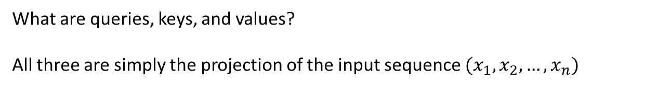
Attention Mechanism
$$q_{1}.k_{1}$$
$$w_{1}$$
$$q_{1}$$
$$k_{1}$$
$$v_{1}$$
$$w_{i}=\frac{e^{q_{1}.k_{i}}}{\sum_{j}{e^{q_{1}.k_{j}}}}$$
$$q_{1}.k_{2}$$
$$k_{2}$$
$$v_{2}$$
$$w_{2}$$
$$q_{2}$$
$$q_{1}.k_{3}$$
$$k_{3}$$
$$v_{3}$$
$$w_{3}$$
$$q_{|Q|}$$
What are queries, keys, and values?
All three are simply the projection of the input sequence $(x_{1}, x_{2},…,x_{n})$

Slide 34
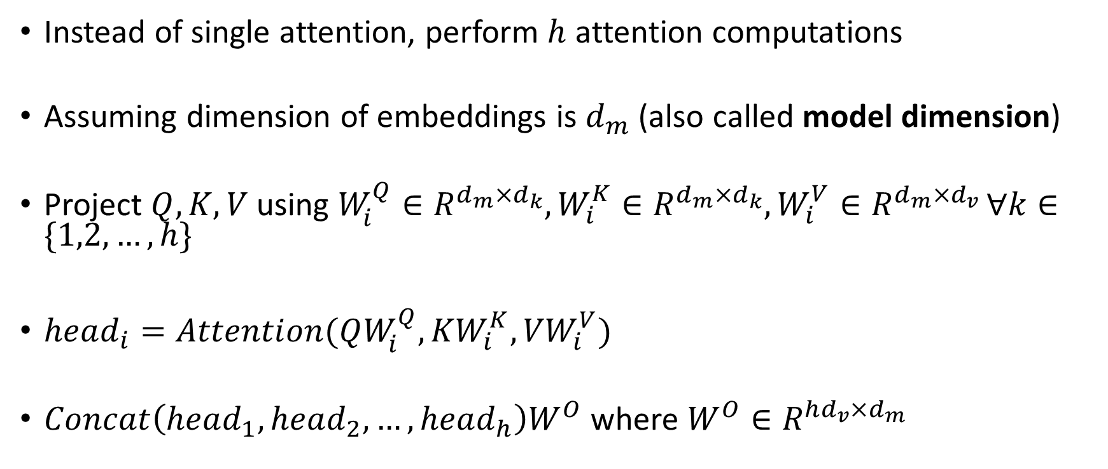
Multi-Headed Attention
Instead of single attention, perform $h$ attention computations
Assuming dimension of embeddings is $d_{m}$ (also called model dimension)
Project $Q, K, V$ using $W_{i}^{Q}∈R^{d_{m}×d_{k}},W_{i}^{K}∈R^{d_{m}×d_{k}},W_{i}^{V}∈R^{d_{m}×d_{v} }∀k∈\{1,2,…,h\}$
$head_{i}=Attention(QW_{i}^{Q},{KW}_{i}^{K},{VW}_{i}^{V})$
$Concat\left(head_{1}, head_{2}, …,head_{h}\right)W^{O}$ where $W^{O}∈R^{hd_{v}×d_{m}}$

Slide 35
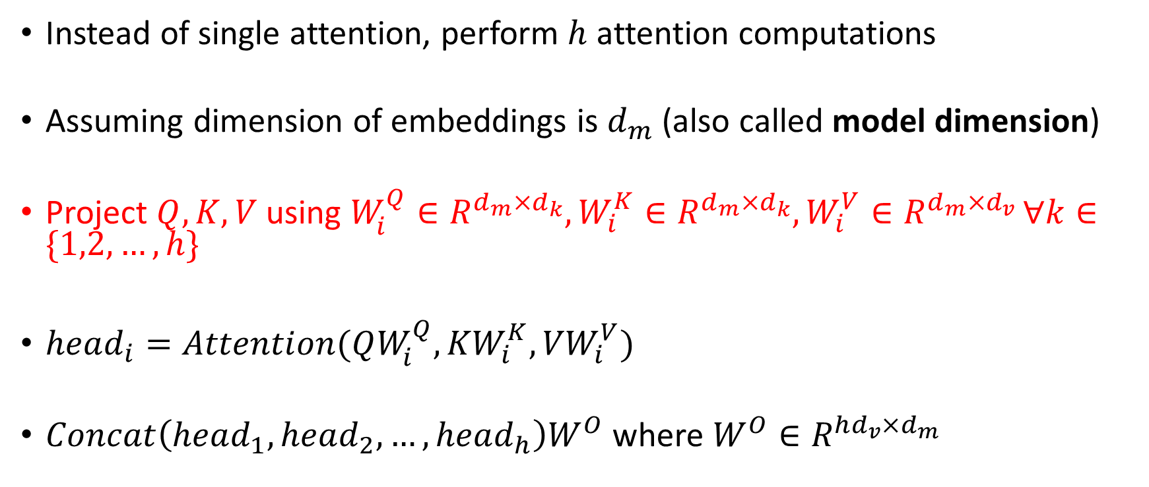
Multi-Headed Attention
Instead of single attention, perform $h$ attention computations
Assuming dimension of embeddings is $d_{m}$ (also called model dimension)
Project $Q, K, V$ using $W_{i}^{Q}∈R^{d_{m}×d_{k}},W_{i}^{K}∈R^{d_{m}×d_{k}},W_{i}^{V}∈R^{d_{m}×d_{v} }∀k∈\{1,2,…,h\}$
$head_{i}=Attention(QW_{i}^{Q},{KW}_{i}^{K},{VW}_{i}^{V})$
$Concat\left(head_{1}, head_{2}, …,head_{h}\right)W^{O}$ where $W^{O}∈R^{hd_{v}×d_{m}}$

Slide 36















Multi-Headed Attention
$$d_{m}$$
$$d_{k}$$
$$d_{k}$$
$$x_{1}$$
$$q_{1}$$
$$x_{2}$$
$$q_{2}$$
$$x_{3}$$
$$q_{3}$$
X
$$d_{m}$$
=
$$L$$
$$L$$
$$X$$
$$W_{i}^{Q}$$
$$Q$$
$$i=\{1,2,…,h\}$$

Slide 37


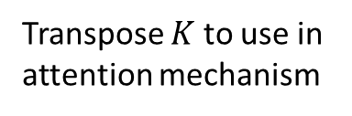



Multi-Headed Attention
$$d_{m}$$
$$d_{k}$$
$$d_{k}$$
$$x_{1}$$
$$k_{1}$$
$$x_{2}$$
$$k_{2}$$
$$x_{3}$$
$$k_{3}$$
X
$$d_{m}$$
=
$$L$$
$$L$$
$$X$$
$$W_{i}^{K}$$
$$K$$
$$i=\{1,2,…,h\}$$
Transpose $K$ to use in attention mechanism

Slide 38







Multi-Headed Attention
$$d_{m}$$
$$d_{v}$$
$$d_{v}$$
$$x_{1}$$
$$v_{1}$$
$$x_{2}$$
$$v_{2}$$
$$x_{3}$$
$$v_{3}$$
X
$$d_{m}$$
=
$$L$$
$$L$$
$$X$$
$$W_{i}^{V}$$
$$V$$
$$i=\{1,2,…,h\}$$

Slide 39
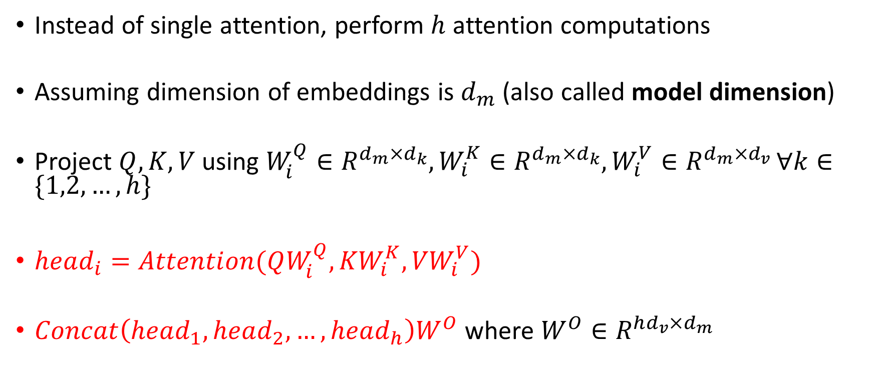
Multi-Headed Attention
Instead of single attention, perform $h$ attention computations
Assuming dimension of embeddings is $d_{m}$ (also called model dimension)
Project $Q, K, V$ using $W_{i}^{Q}∈R^{d_{m}×d_{k}},W_{i}^{K}∈R^{d_{m}×d_{k}},W_{i}^{V}∈R^{d_{m}×d_{v} }∀k∈\{1,2,…,h\}$
$head_{i}=Attention(QW_{i}^{Q},{KW}_{i}^{K},{VW}_{i}^{V})$
$Concat\left(head_{1}, head_{2}, …,head_{h}\right)W^{O}$ where $W^{O}∈R^{hd_{v}×d_{m}}$

Slide 40
Multi-Headed Attention
$$Attention(Q,K,V)$$
$$d_{k}$$
$$d_{v}$$
$$q_{1}$$
$$v_{1}$$
$$q_{2}$$
$$v_{2}$$
$$q_{3}$$
$$v_{3}$$
Softmax
$$|Q|$$
X
$$k_{1}$$
$$k_{2}$$
$$k_{3}$$
X
$$|K|$$
$$d_{k}$$
$$|K|$$
Perform attention for each head $i$
X: Matrix MM

Slide 41





Multi-Headed Attention
$$O= Attention(Q,K,V)$$
$$d_{v}$$
$$o_{1}$$
$$o_{2}$$
$$o_{3}$$
$$L$$
Perform attention for each head $i$
X: Matrix MM

Slide 42








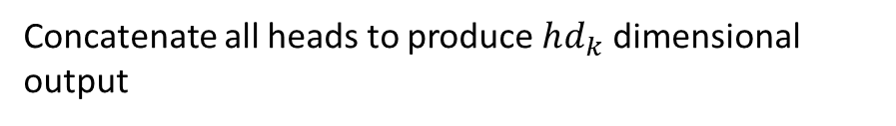

Multi-Headed Attention
$$O= Attention(Q,K,V)$$
$$d_{v}$$
$$d_{v}$$
$$o_{1}$$
$$o_{1}$$
$$o_{2}$$
$$o_{2}$$
$$o_{3}$$
$$o_{3}$$
…
$$L$$
Concatenate all heads to produce $hd_{k}$ dimensional output

Slide 43
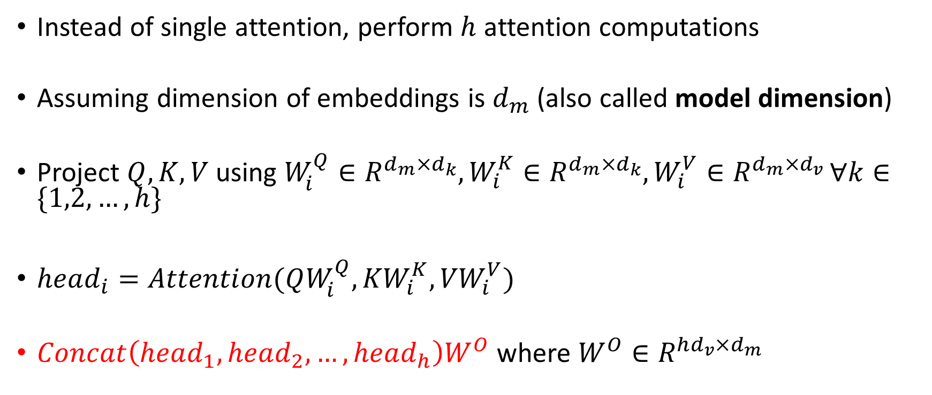
Multi-Headed Attention
Instead of single attention, perform $h$ attention computations
Assuming dimension of embeddings is $d_{m}$ (also called model dimension)
Project $Q, K, V$ using $W_{i}^{Q}∈R^{d_{m}×d_{k}},W_{i}^{K}∈R^{d_{m}×d_{k}},W_{i}^{V}∈R^{d_{m}×d_{v} }∀k∈\{1,2,…,h\}$
$head_{i}=Attention(QW_{i}^{Q},{KW}_{i}^{K},{VW}_{i}^{V})$
$Concat\left(head_{1}, head_{2}, …,head_{h}\right)W^{O}$ where $W^{O}∈R^{hd_{v}×d_{m}}$

Slide 44




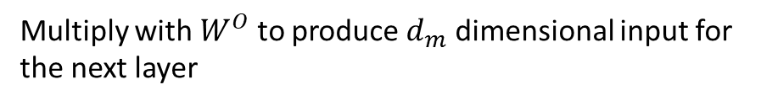


Multi-Headed Attention
$$O= Attention(Q,K,V)$$
$$d_{v}$$
$$d_{v}$$
$$d_{m}$$
$$o_{1}$$
$$o_{1}$$
$$o_{2}$$
$$o_{2}$$
$$o_{3}$$
$$o_{3}$$
X
$${hd}_{v}$$
$$L$$
Multiply with $W^{O}$ to produce $d_{m}$ dimensional input for the next layer

Slide 45




Multi-Headed Attention
Input to the next layer is again a sequence of dimension $d_{m}$ - model size
$$d_{m}$$
$$x_{1}^{o}$$
$$x_{2}^{o}$$
$$x_{3}^{o}$$
$$L$$

Slide 46




Multi-head Attention
$$W^{O}$$
$$W_{i}^{V}$$
$$W_{i}^{Q}$$
$$W_{i}^{K}$$

Slide 47
Transformer Block
Contains two sub-layers
Attention Mechanism
Feed Forward Network

Slide 48

Feed-Forward Network
Simply a 2 layer fully connected network
Input dimension = $d_{m}$
Hidden dimension = $d_{ff}$
Output dimension = $d_{m}$

Slide 49
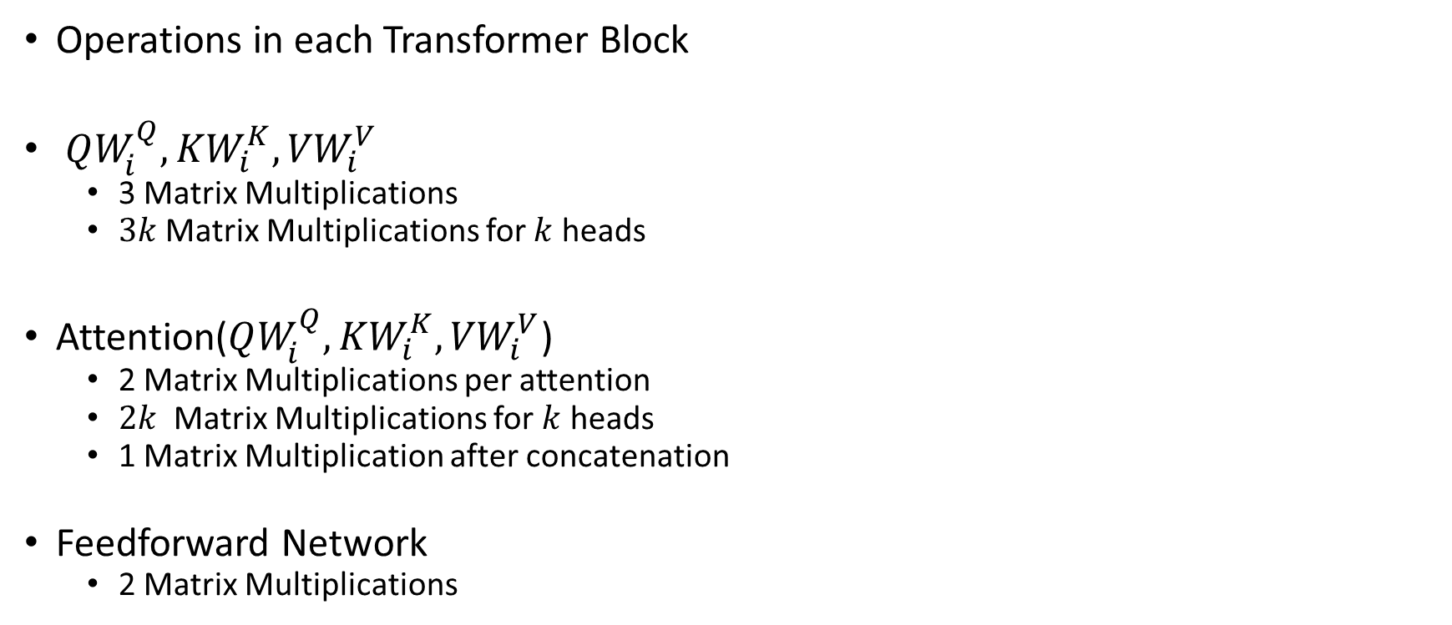
Computationally
Operations in each Transformer Block
$QW_{i}^{Q},{KW}_{i}^{K},{VW}_{i}^{V}$
3 Matrix Multiplications
$3k$ Matrix Multiplications for $k$ heads
Attention($QW_{i}^{Q},{KW}_{i}^{K},{VW}_{i}^{V}$)
2 Matrix Multiplications per attention
$2k$ Matrix Multiplications for $k$ heads
1 Matrix Multiplication after concatenation
Feedforward Network
2 Matrix Multiplications

Slide 50
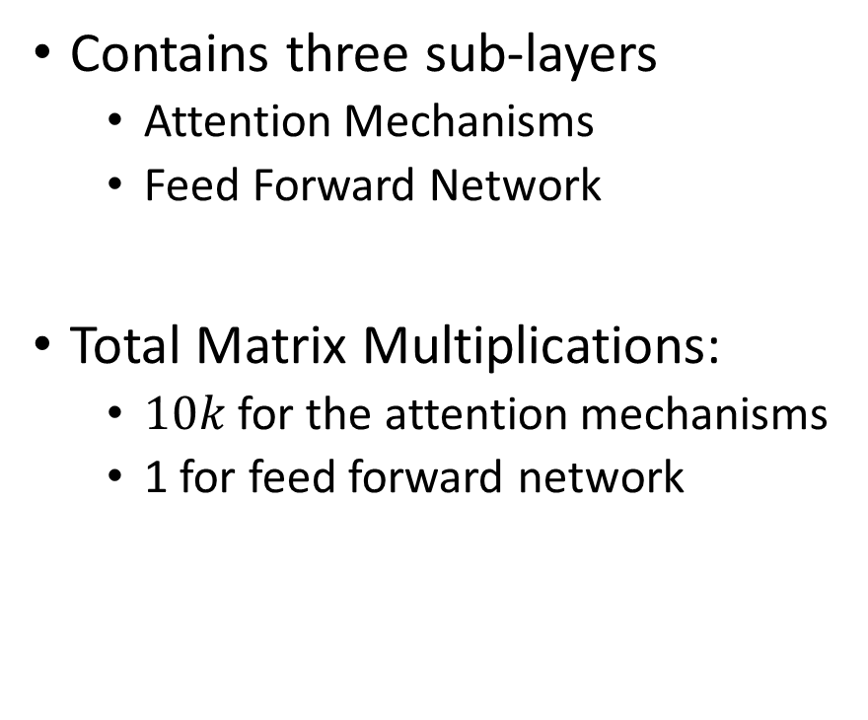

Transformer Decoder Block
Contains three sub-layers
Attention Mechanisms
Feed Forward Network
Total Matrix Multiplications:
$10k$ for the attention mechanisms
1 for feed forward network
$$(z_{1},z_{2},…,z_{n})$$

Slide 51
Outline
Project Information
Transformer Models
Challenges in Transformer Models

Slide 52
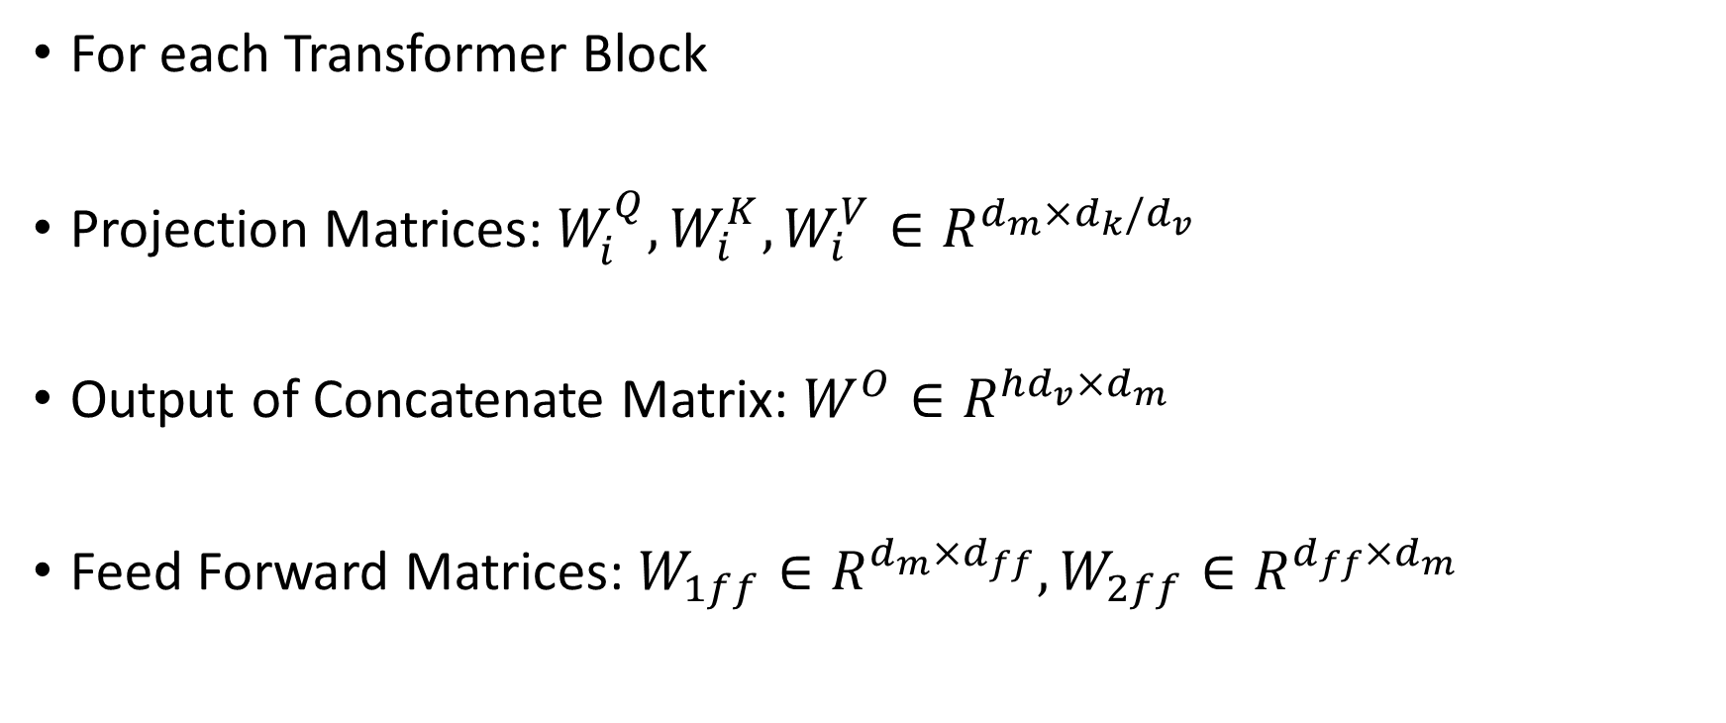
Learnable Parameters
For each Transformer Block
Projection Matrices: $W_{i}^{Q},W_{i}^{K},W_{i}^{V}∈R^{d_{m}×d_{k}/d_{v}}$
Output of Concatenate Matrix: $W^{O}∈R^{hd_{v}×d_{m}}$
Feed Forward Matrices: $W_{1ff}∈R^{d_{m}×d_{ff}}, W_{2ff}∈R^{d_{ff}×d_{m}}$

Slide 53
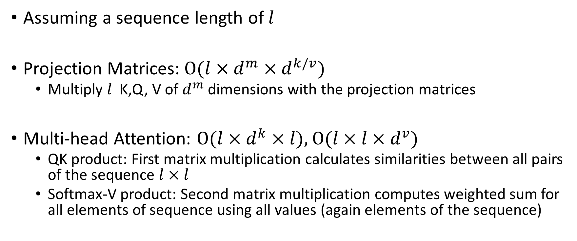
Matrix Multiplication Operations
Assuming a sequence length of $l$
Projection Matrices: $O(l×d^{m}×d^{k/v})$
Multiply $l$ K,Q, V of $d^{m}$dimensions with the projection matrices
Multi-head Attention: $O(l×d^{k}×l),$ $O(l×l×d^{v})$
QK product: First matrix multiplication calculates similarities between all pairs of the sequence $l×l$
Softmax-V product: Second matrix multiplication computes weighted sum for all elements of sequence using all values (again elements of the sequence)

Slide 54
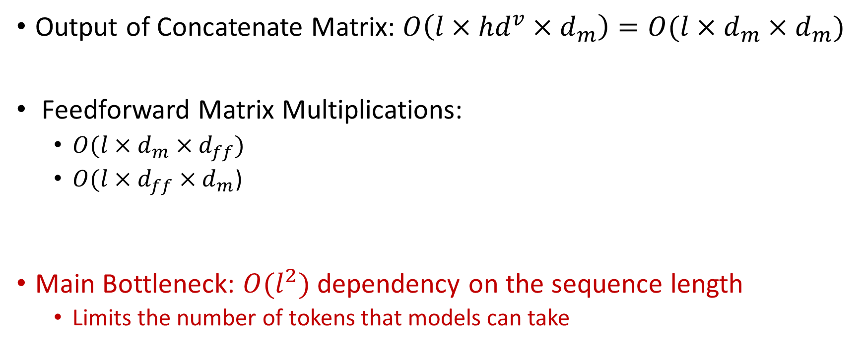
Matrix Multiplication Operations
Output of Concatenate Matrix: $O\left(l×hd^{v}×d_{m}\right)=O(l×d_{m}×d_{m})$
Feedforward Matrix Multiplications:
$O({l×d}_{m}×d_{ff})$
$O(l×d_{ff}×d_{m}$)
Main Bottleneck: $O(l^{2})$ dependency on the sequence length
Limits the number of tokens that models can take

Slide 55
Memory Requirements
Training/Fine-tuning: Learn the LLM model using a large corpus of data
Inference: Query the model to obtain output

Slide 56
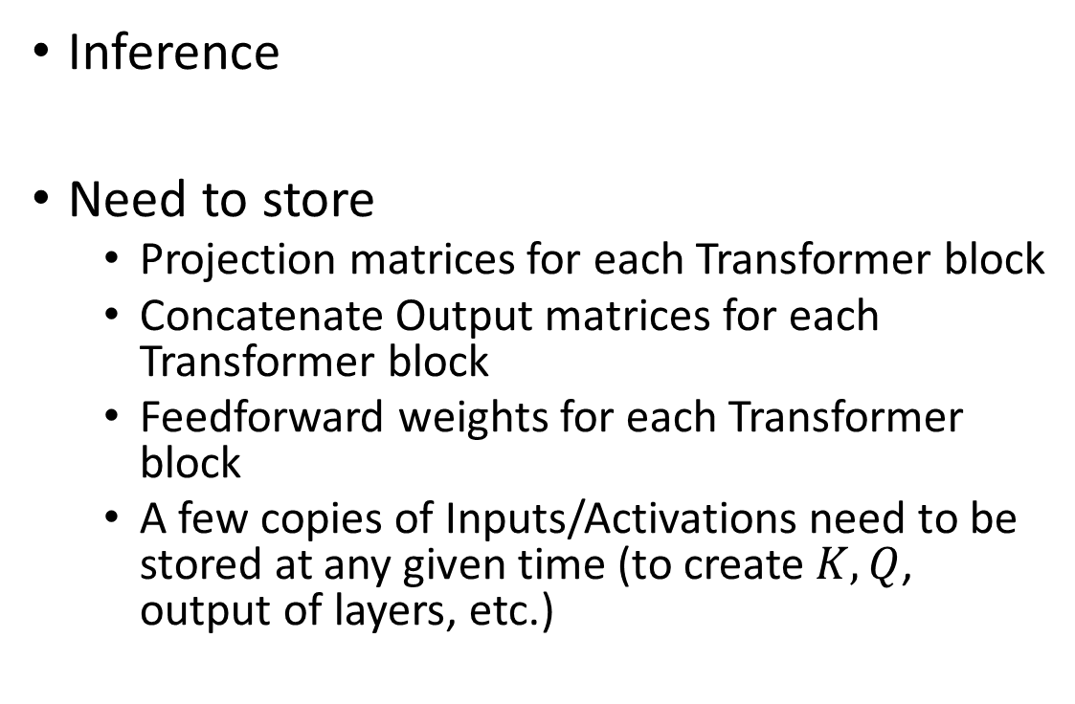
Memory Requirements
Inference
Need to store
Projection matrices for each Transformer block
Concatenate Output matrices for each Transformer block
Feedforward weights for each Transformer block
A few copies of Inputs/Activations need to be stored at any given time (to create $K, Q$, output of layers, etc.)

Slide 57
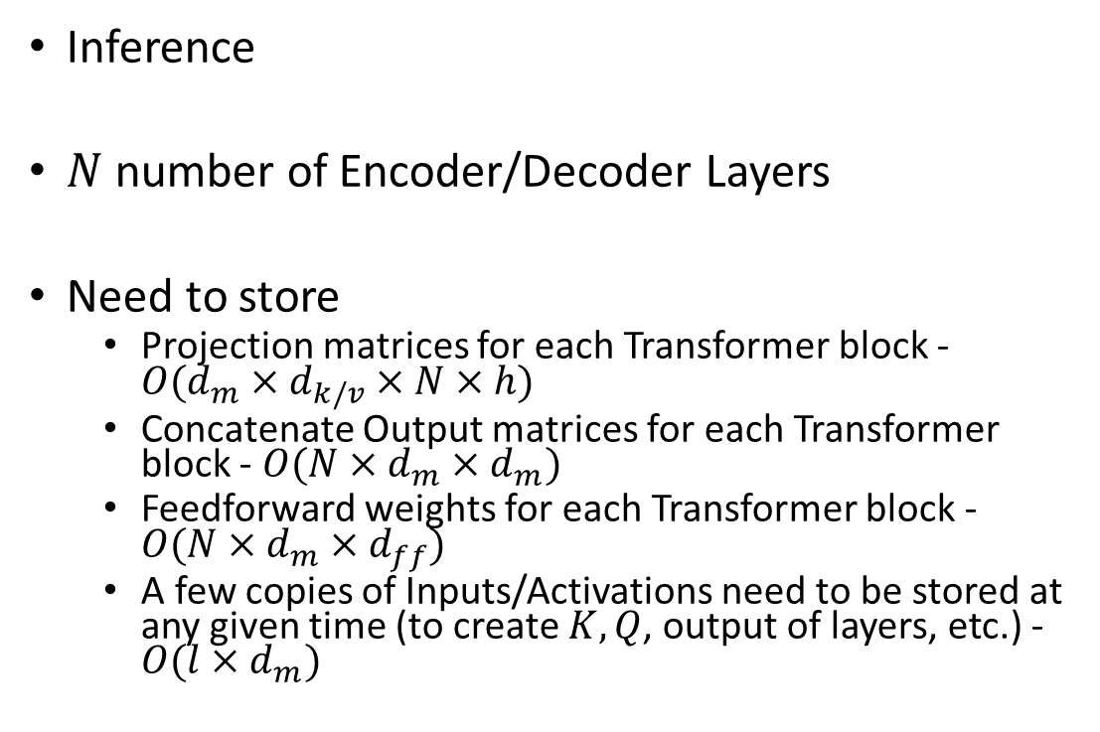
Memory Requirements
Inference
$N$ number of Encoder/Decoder Layers
Need to store
Projection matrices for each Transformer block - $O(d_{m}×d_{k/v}×N×h)$
Concatenate Output matrices for each Transformer block - $O(N×d_{m}×d_{m})$
Feedforward weights for each Transformer block - $O(N×d_{m}×d_{ff})$
A few copies of Inputs/Activations need to be stored at any given time (to create $K, Q$, output of layers, etc.) - $O(l×d_{m})$

Slide 58
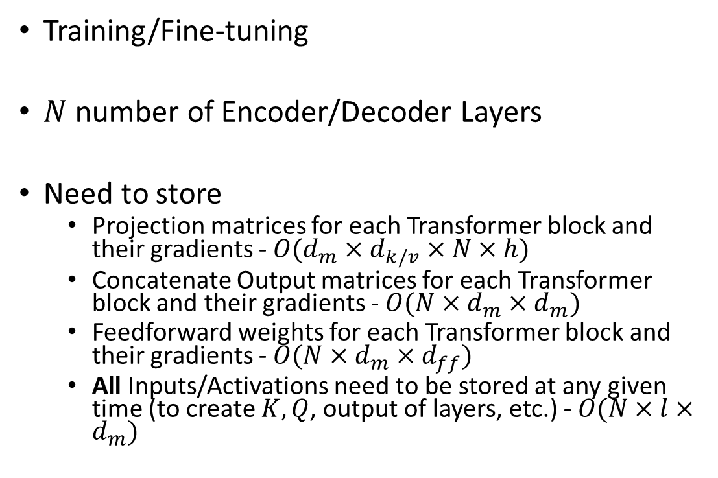
Memory Requirements
Training/Fine-tuning
$N$ number of Encoder/Decoder Layers
Need to store
Projection matrices for each Transformer block and their gradients - $O(d_{m}×d_{k/v}×N×h)$
Concatenate Output matrices for each Transformer block and their gradients - $O(N×d_{m}×d_{m})$
Feedforward weights for each Transformer block and their gradients - $O(N×d_{m}×d_{ff})$
All Inputs/Activations need to be stored at any given time (to create $K, Q$, output of layers, etc.) - $O(N×l×d_{m})$

Slide 59
Memory Requirements
Why do we need to store ALL Inputs/Activations?

Slide 60





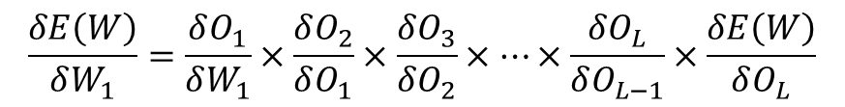


Memory Requirements
Why do we need to store ALL Inputs/Activations? Recall from CNN.
Here, we need matrix multiplications instead of Conv
$$W_{1}$$
$$O_{1}$$
$$W_{2}$$
$$O_{2}$$
…
$$W_{L}$$
$$O_{L}$$
$$y$$
$$\frac{δE\left(W\right)}{δW_{1}}=\frac{δO_{1}}{δW_{1}}×\frac{δO_{2}}{δO_{1}}×\frac{δO_{3}}{δO_{2}}×…×\frac{δO_{L}}{δO_{L−1}}×\frac{δE\left(W\right)}{δO_{L}}$$

Slide 61
Memory Requirements – Going Deeper
Excellent paper that explains the memory requirements by Microsoft Research
Rajbhandari, S., Rasley, J., Ruwase, O., & He, Y. (2020, November). Zero: Memory optimizations toward training trillion parameter models. In SC20: International Conference for High Performance Computing, Networking, Storage and Analysis (pp. 1-16). IEEE.

Slide 62
Memory Requirements – Going Deeper
Analysis from the paper
Consider 1.5 Billion parameter GPT-2 model.
Each parameter requires 2 bytes
Total memory needed for the parameters???

Slide 63
Memory Requirements – Going Deeper
Analysis from the paper
Consider 1.5 Billion parameter GPT-2 model.
Each parameter requires 2 bytes
Total memory needed for the parameters – 3 GB

Slide 64
Memory Requirements – Going Deeper
Consider a GPU with 32 GB memory
Consider the GPT model that requires 3 GB memory.
Can we train it on the GPU???

Slide 65
Memory Requirements – Going Deeper
Consider a GPU with 32 GB memory
Consider the GPT model that requires 3 GB memory.
Can we train it on the GPU – No
Optimizer states and residual memory consume a significant portion of memory

Slide 66
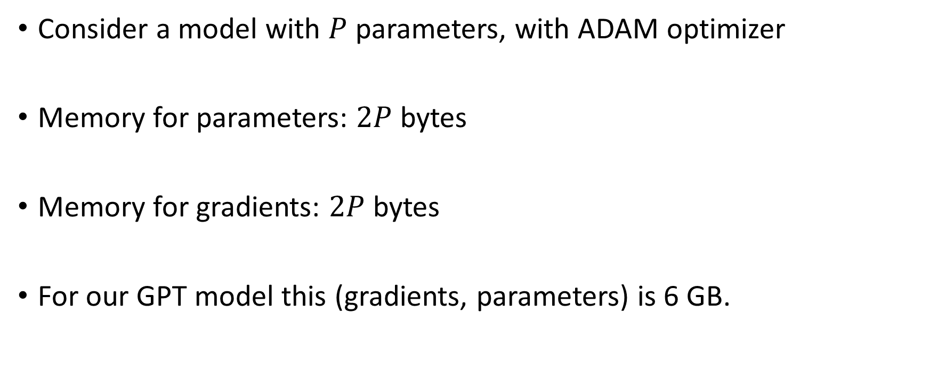
Memory Requirements – Going Deeper
Consider a model with $P$ parameters, with ADAM optimizer
Memory for parameters: $2P$ bytes
Memory for gradients: $2P$ bytes
For our GPT model this (gradients, parameters) is 6 GB.

Slide 67
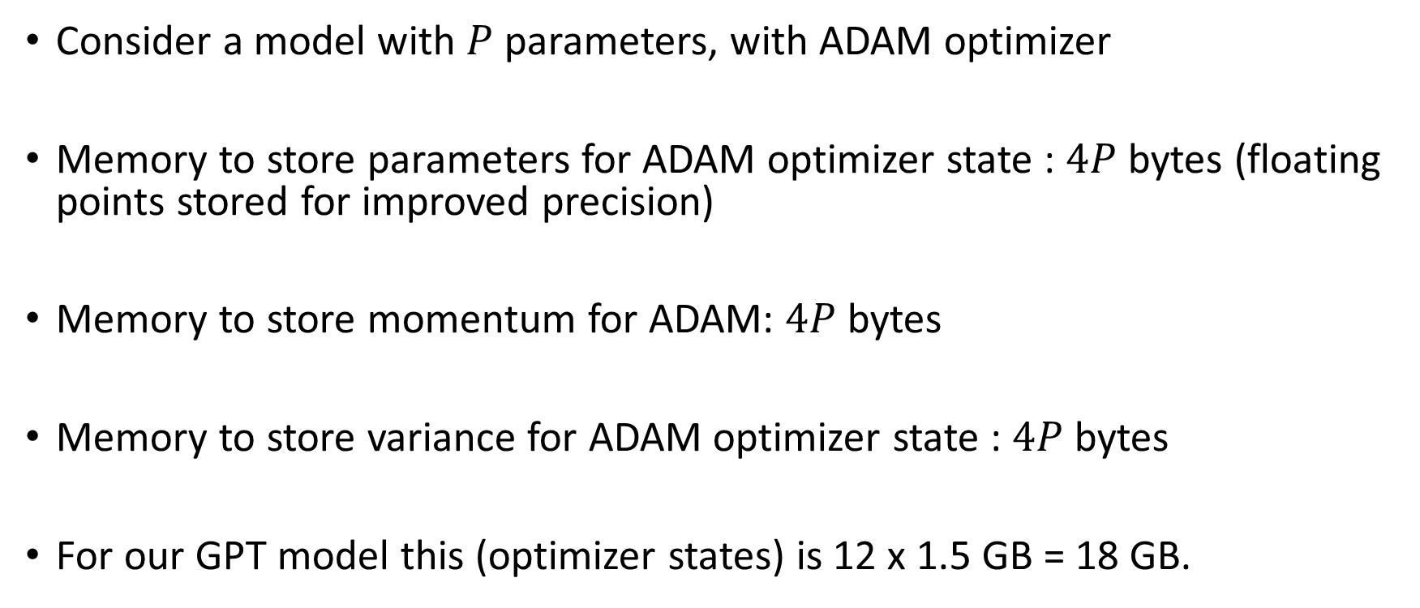
Memory Requirements – Going Deeper
Consider a model with $P$ parameters, with ADAM optimizer
Memory to store parameters for ADAM optimizer state : $4P$ bytes (floating points stored for improved precision)
Memory to store momentum for ADAM: $4P$ bytes
Memory to store variance for ADAM optimizer state : $4P$ bytes
For our GPT model this (optimizer states) is 12 x 1.5 GB = 18 GB.

Slide 68
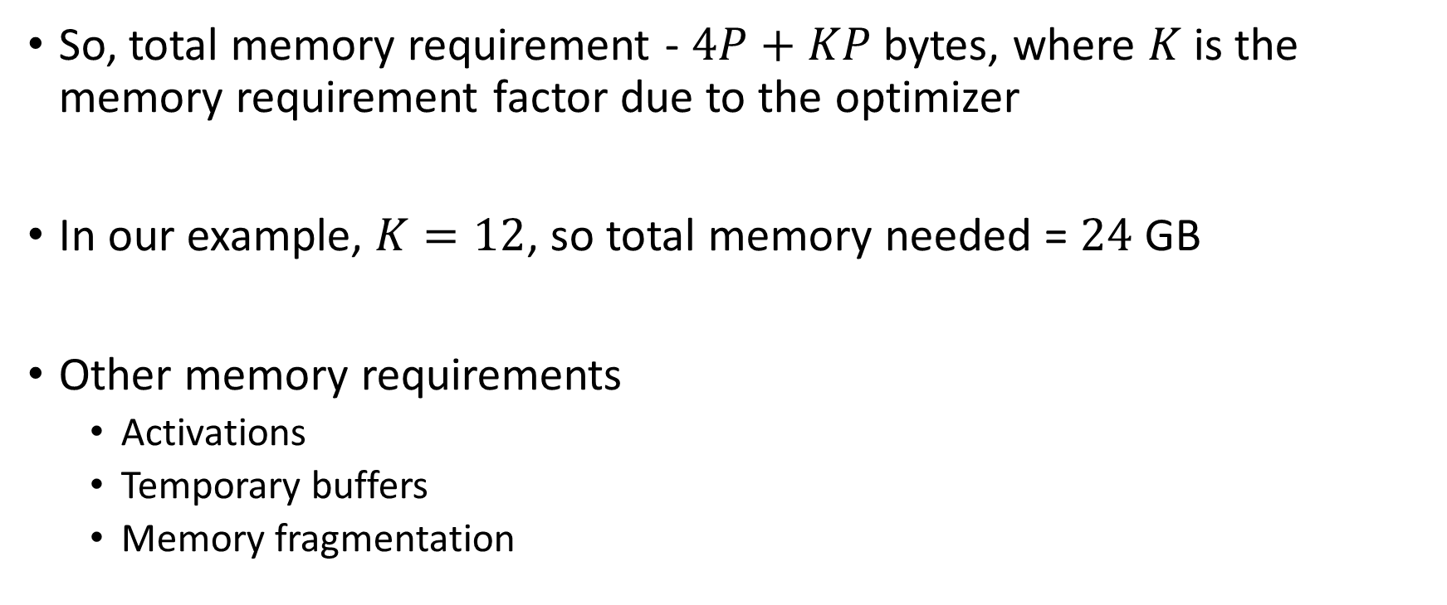
Memory Requirements – Going Deeper
So, total memory requirement - $4P+KP$ bytes, where $K$ is the memory requirement factor due to the optimizer
In our example, $K=12$, so total memory needed = $24$ GB
Other memory requirements
Activations
Temporary buffers
Memory fragmentation

Slide 69
Memory Requirements – Going Deeper
Memory for Activations
Our GPT model with 1K sequence length and batch size of 32 will require 60 GB (equation provided in the paper)

Slide 70
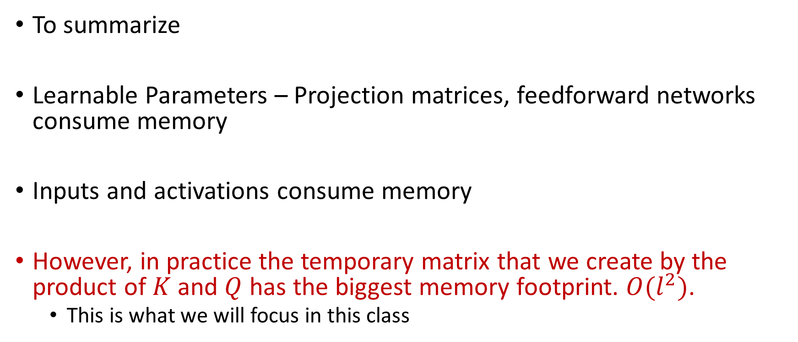
Accelerating Transformer Models
To summarize
Learnable Parameters – Projection matrices, feedforward networks consume memory
Inputs and activations consume memory
However, in practice the temporary matrix that we create by the product of $K$ and $Q$ has the biggest memory footprint. $O(l^{2})$.
This is what we will focus in this class

Slide 71
Accelerating Transformer Models
Ungraded HW assignment
Read the Microsoft Paper and understand as much as you can
We did not have time to go into it detail now. We will revisit this paper and related optimizations when we do distributed training.

Slide 72
Accelerating Transformer Models
Approaches for Accelerating LLMs
Tiled attention calculation to improve cache reuse: Flashattention
Sparsity to reduce the number of attentions or quantization
Brief Overview of Other techniques: Kernel methods, alternates to attention for sequence modeling, KV Caching
Distributed Training

Slide 73
Next Class
10/23 Lecture 16
Accelerating Transformer Model: Sparsity

Slide 74
Thank You
Questions?
Email: sanmukh.kuppannagari@case.edu

